Slide 2
CNET Team, Intelligent Systems Research Centre, School of Computing, Engineering & Intelligent Systems, Ulster University, Magee Campus, Derry, Northern Ireland
Ionostasis at the Tripartite Synapse
Marinus Toman, Liam McDaid & John Wade

Slide 3
Introduction
Astrocytes Neurons
Dev & Use of Models
Neuronal AP Model
Neuron Model Tutorial
Tripartite Synapse
Astrocyte Channels
Astrocyte Model Tutorial
Astrocyte Modelling
Neuron-Astroglial Interaction Model

Slide 4
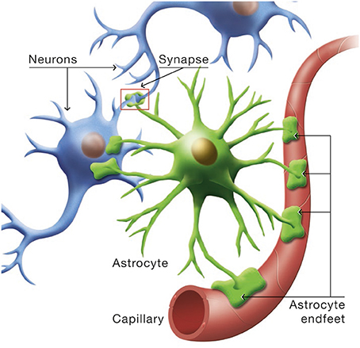
Background
Neurons
Carry brain’s electrical signals
Astrocytes
Support cells - various roles
Neuro-Astro Interactions
Synapse
Astrocyte signalling

Slide 5
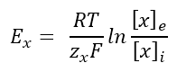
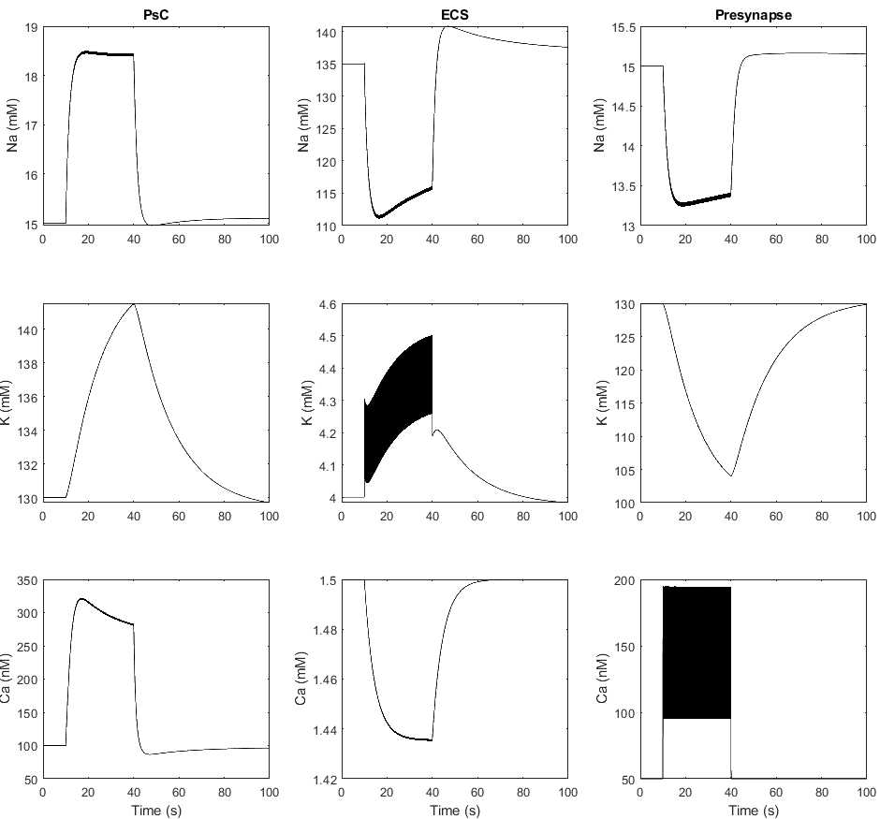
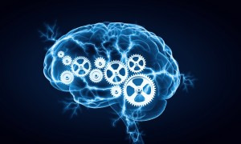
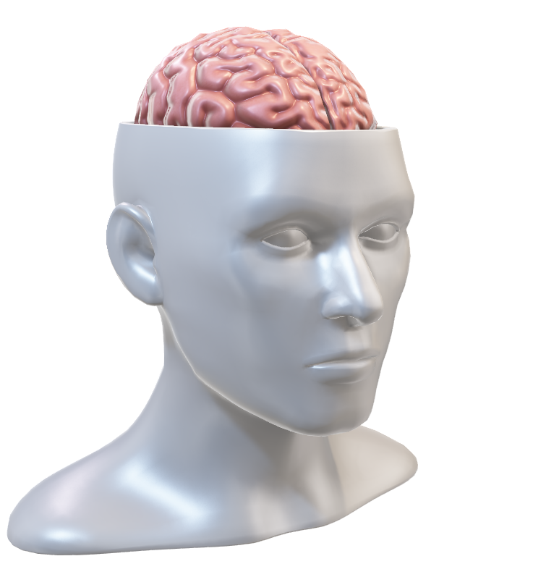
Development and Use of Model
Math
Code
Create model
Validate
Analyse
Predict
Experiments
Test
Compare
Edit

Slide 6
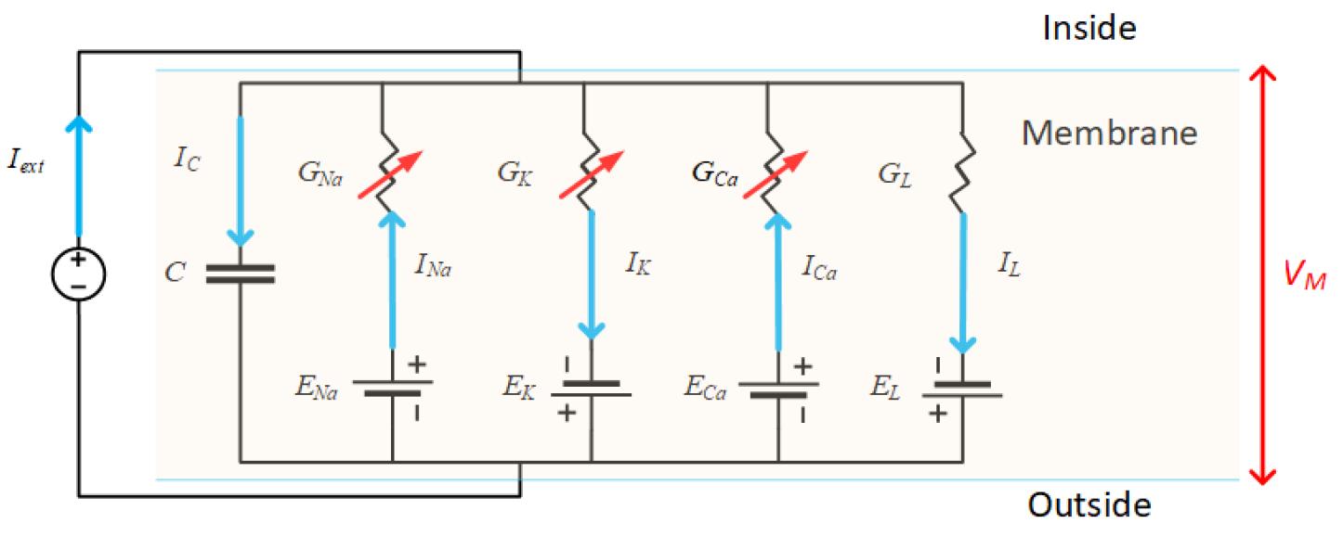
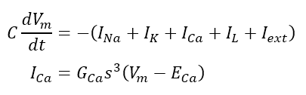
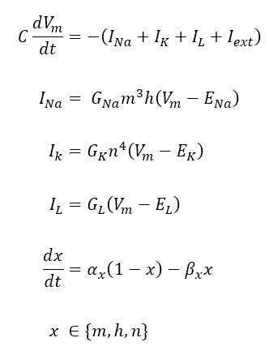
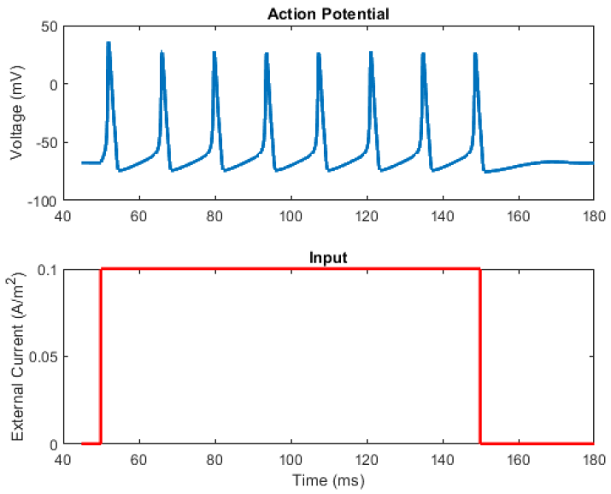
Neuron Action Potential Model
Changing Membrane Potential
Ion Channel Currents
Ion Channel Gating Kinetics
Reference: A. L. Hodgkin and A. F. Huxley, “A quantitative description of membrane current and its application to conduction and excitation in nerve.,” J. Physiol., vol. 117, no. 4, pp. 500–44, Aug. 1952, doi: 10.1007/BF02459568.

Slide 7
Tutorial / Demonstration
Hodgkin-Huxley Neuron Action Potential Model:
Solving HH model with the MATLAB ODE solver

Slide 8
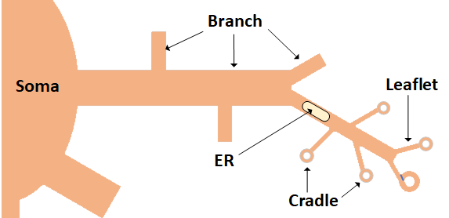
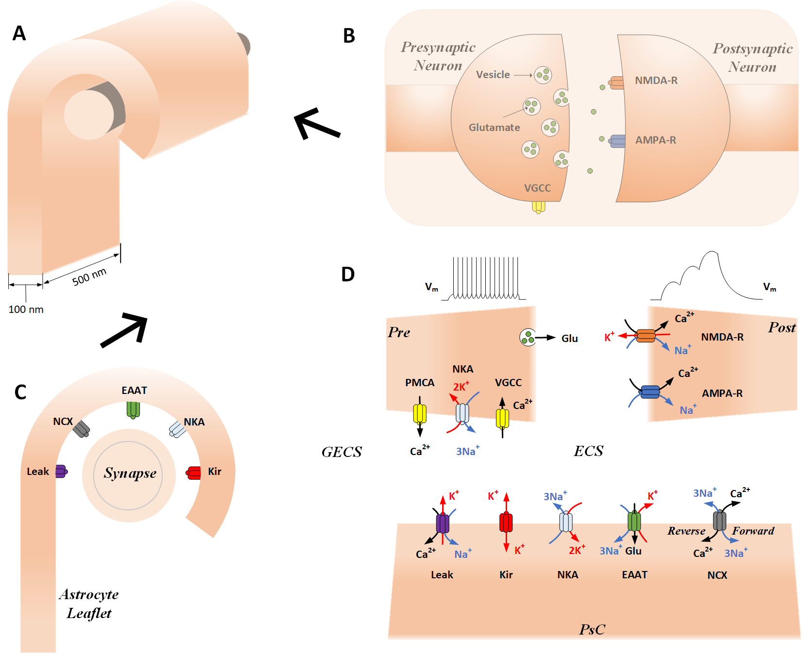
Astrocyte Modelling
Cradle
Different levels of models
astrocyte networks
single cells
sub-cellular
Cradle
Same modelling techniques as neurons
channels/transporters in a membrane
astrocytes typically have different channels than neurons
Synapse
Leaflet

Slide 9
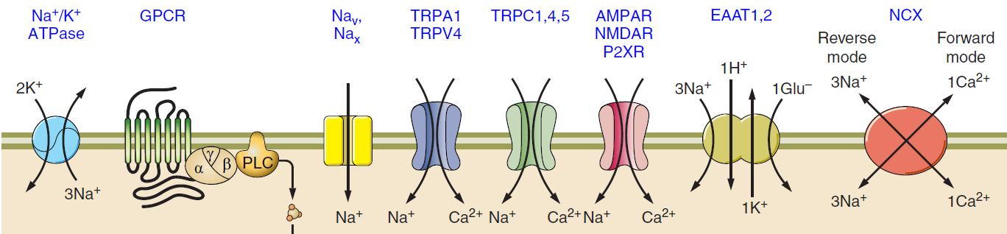
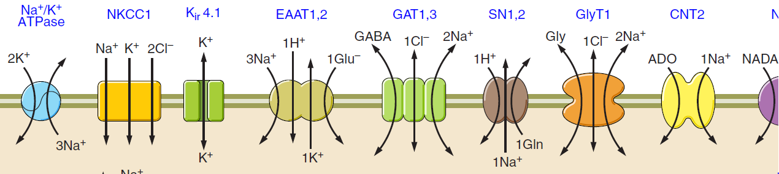
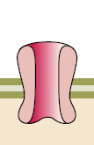
Receptors / Channels
VGCC
Ca²⁺
Reference: Verkhratsky A, Nedergaard M. Physiology of Astroglia. Physiol Rev 98: 239–389, 2018. doi:10.1152/physrev.00042.2016.

Slide 10
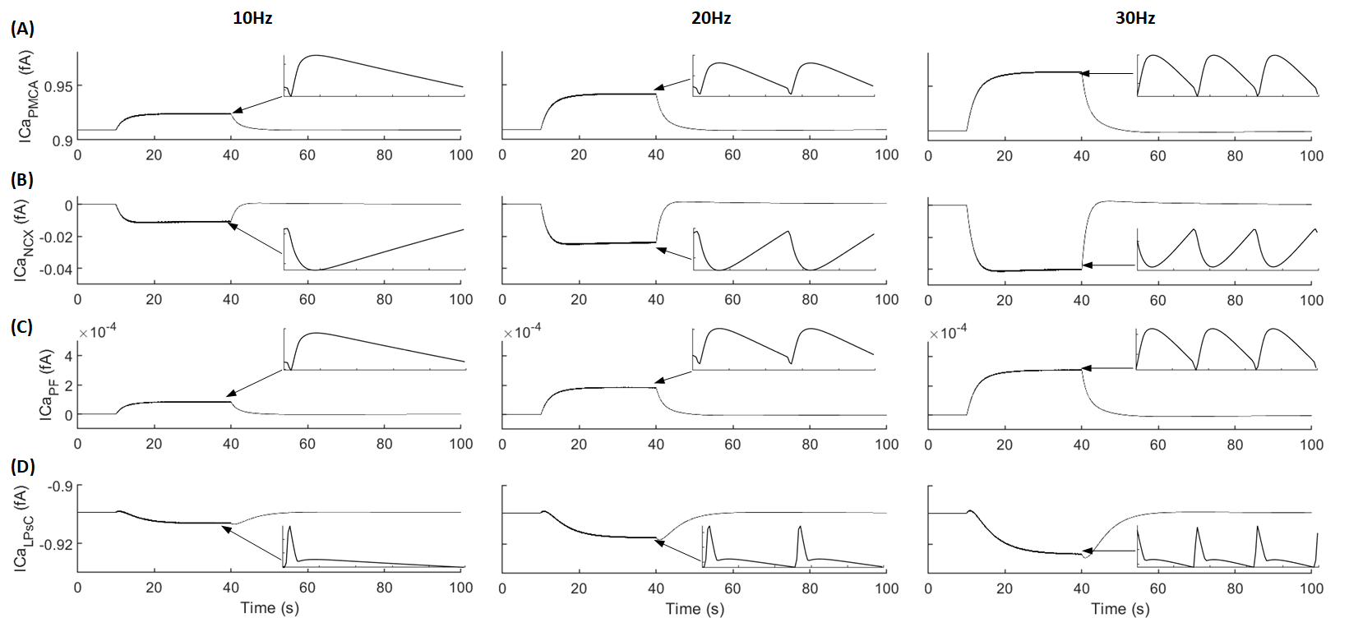
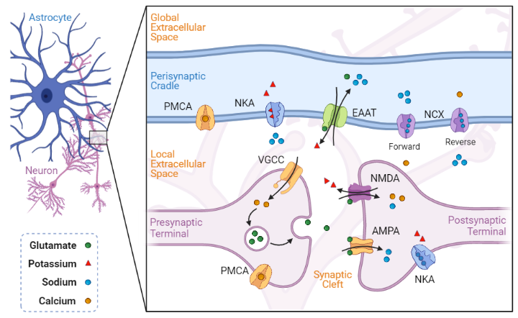
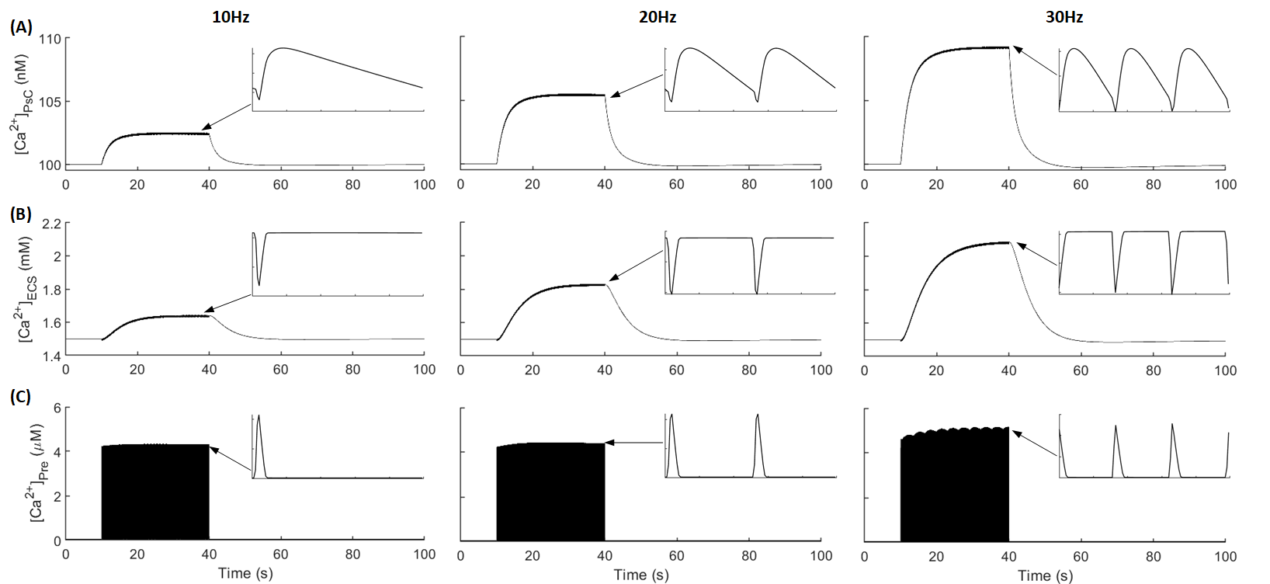
Ionostasis at the Tripartite Synapse

Slide 11
Tutorial / Demonstration
Astrocyte Homeostasis Model:
Solving model with Euler’s method

Slide 12
Conclusion
Astrocytes Neurons
Dev & Use of Models
Neuronal AP Model
Neuron Model Tutorial
Model Parameter Exploration
Neuron-Astroglial Interaction Model
Tripartite Synapse
Astrocyte Channels
Astrocyte Model Tutorial
Astrocyte Modelling

